Slide 1
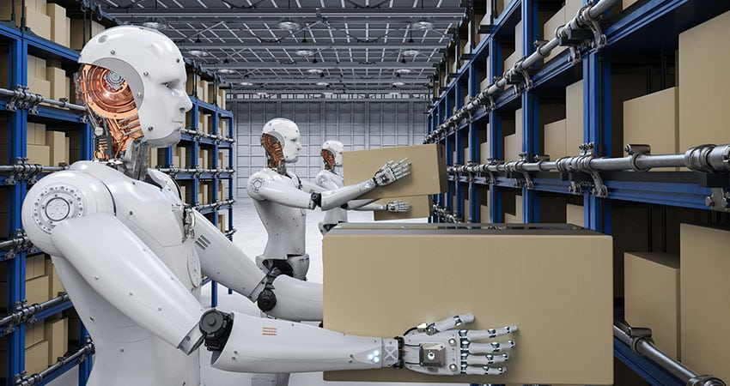
Smart Cart
Warehouse Automation
Team SmartCart

Slide 2
Most Common Complains – We Hear
We are totally out of space and about to increase our offsite space
We do not feel we are using our existing space very efficiently
Accuracy on customer orders is a problem for us
Our financial accuracy is fine, but our warehouse accuracy at the location level is much lower
Because of our distribution center accuracy problems, we are auditing 100% of orders after pickers complete them
The inventory accuracy at our last physical inventory was lower than any time in the past five years
We need to improve productivity without breaking the bank
There is a lot of pressure from executive management to lower our operating costs,,, NOW
Warehouse productivity is declining, and we do not understand the causes
We budgeted for an improvement in distribution center productivity, and now we have to deliver on that promise

Slide 3
Technology Used
Backend
Frontend
Python Server
MongoDB database
Android Application
Quick canvas Map
Cart
Raspberry pi3
Sonar Sensor
Motor Shields and wheels

Slide 4
Python Application on cloud platform

Slide 5
Python Application on cloud platform(Application)

Slide 6
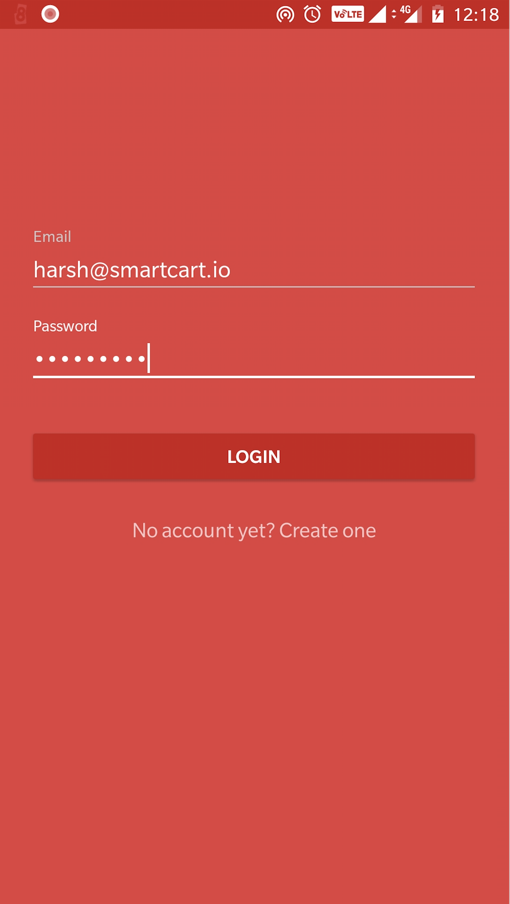
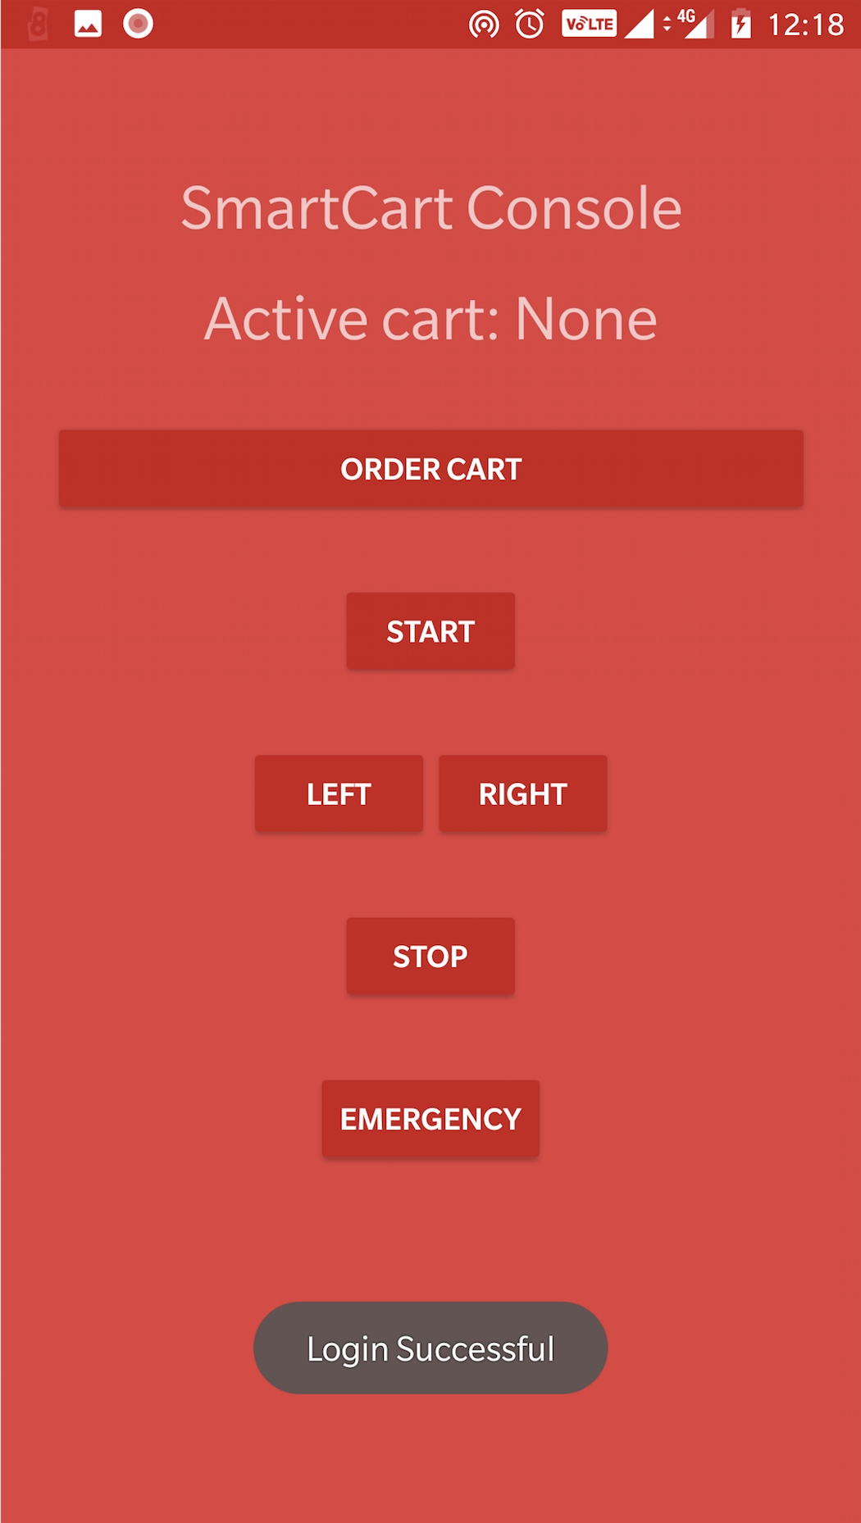
Android Application

Slide 7
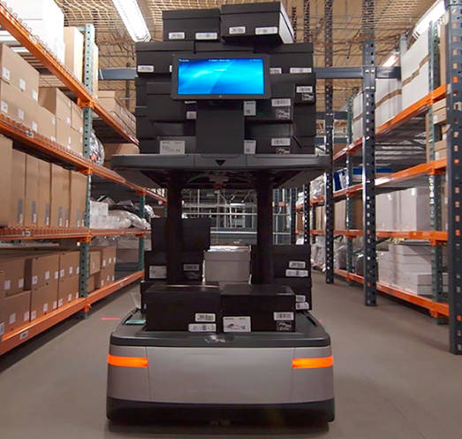
Welcome to the Future
Imagine you walk into a dimly lit warehouse where the only sound you hear is of Robotic Motors
A warehouse completely operated by robots
Self Driving Robotic Pallet and Fork Lift
Robotic Picker
Robotic Packers
Minimal human intervention
All Receiving, Storing, Picking and Packing is done by robotic systems 24/7
Notes:
You don’t need bright warehouses as the robots are sent specific instruction of where a particular article is located
You don’t need heating to maintain working conditions
You don’t need bio breaks or lunch/diner breaks
Operations can continue 24/7

Slide 8
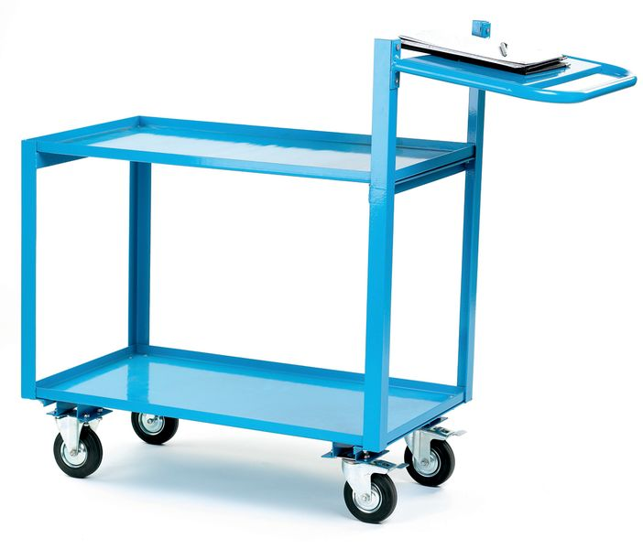
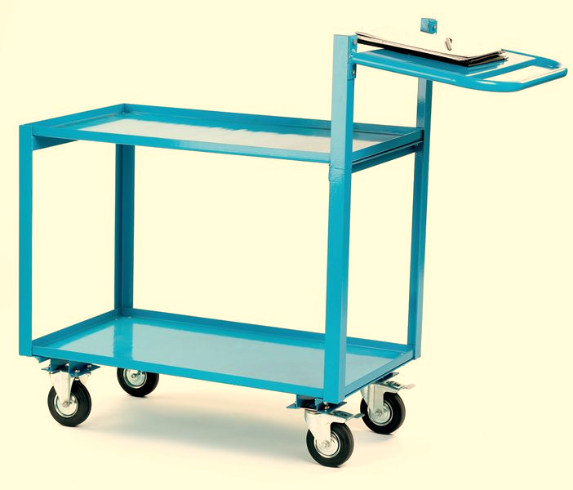



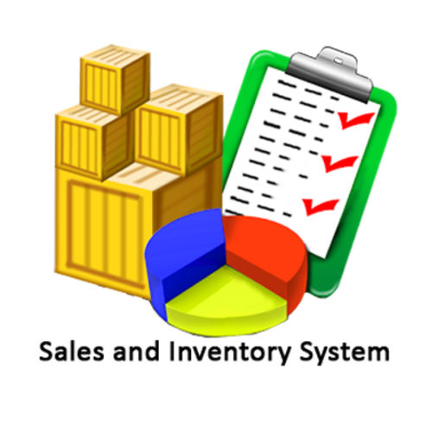
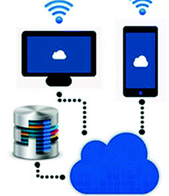
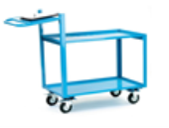

How does it work
Empty
Full
Packed
Retail + Online Store
Customer buys in store or online
Inventory is depleted based on store + online order
Sales is posted and stock is allocated
Warehouse Pick List is generated and assigned to user
Cart to check battery status prior to assignment
If Smart Cart weight cross the weight threshold, communicate with cloud app to request a cart
Trolley to check weight loaded and communicate with cloud app
Each Smart Cart is enabled with Weight Sensor, Battery Check, Sonar/Laser for obstacle avoidance
If battery is sufficient, Smart Cart is assigned to user
User to pick stock and load the trolley or user to initiate movement to packing area
Cart to check battery status prior to assignment
If battery is sufficient, Smart Cart is assigned to user
Cloud app to send a command to the full cart to proceed to packing area
Cloud app to update S/4, Hybris with order status to provide real time visibility
Sonar/Laser sensors to check for obstacles, Cart to get location coordinates thru WIFI
Picking to continue
Goods Dispatched
Delivery Smart Cart moves packed boxes to dispatch bay
Packing team to pack and place in boxes in Delivery Cart
Empty Cart to move to Cart Bay
Cart reaches Packing Area and is emptied
Cart to stop if there are any obstacles in the path. And resume once the obstacle moves

Slide 9
Thank you

